Slide 1
Demonstrate OSI model with physical connectivity Made by Rishabh Pandey

Slide 2
Introduction
OSI stands for Open Systems Interconnection , where open stands to say non-proprietary. It is a 7-layer architecture with each layer having specific functionality to perform. All these 7 layers work collaboratively to transmit the data from one person to another across the globe. The OSI reference model was developed by ISO – ‘International Organization for Standardization ‘, in the year 1984.
The OSI model provides a theoretical foundation for understanding network communication . However, it is usually not directly implemented in its entirety in real-world networking hardware or software . Instead, specific protocols and technologies are often designed based on the principles outlined in the OSI model to facilitate efficient data transmission and networking operations

Slide 3
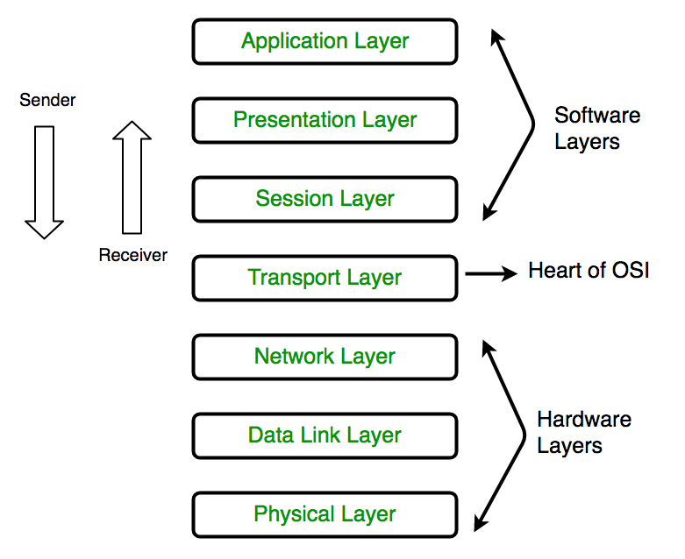
Layers of OSI model
Layer 7: Application
Layer 6 : Presentation
Layer 5 : Session
Layer 4 : Transport
Layer 3 : Network
Layer 2 : Data Link
Layer 1 : Physical

Slide 4
Application layer
At the very top of the OSI Reference Model stack of layers, we find the Application layer which is implemented by the network applications. These applications produce the data to be transferred over the network. This layer also serves as a window for the application services to access the network and for displaying the received information to the user.
Example : Application – Browsers, Skype Messenger, etc.
Functions of the Application Layer
Network Virtual Terminal(NVT): It allows a user to log on to a remote host.
File Transfer Access and Management(FTAM): This application allows a user to access files in a remote host, retrieve files in a remote host, and manage or control files from a remote computer.
Mail Services: Provide email service.
Directory Services: This application provides distributed database sources and access for global information about various objects and services.

Slide 5
Presentation layer
The presentation layer is also called the Translation layer . The data from the application layer is extracted here and manipulated as per the required format to transmit over the network.
Functions of the Presentation Layer
Translation: For example, ASCII to EBCDIC .
Encryption/ Decryption: Data encryption translates the data into another form or code. The encrypted data is known as the ciphertext and the decrypted data is known as plain text. A key value is used for encrypting as well as decrypting data.
Compression: Reduces the number of bits that need to be transmitted on the network.
Note: Device or Protocol Use: JPEG, MPEG, GIF.

Slide 6
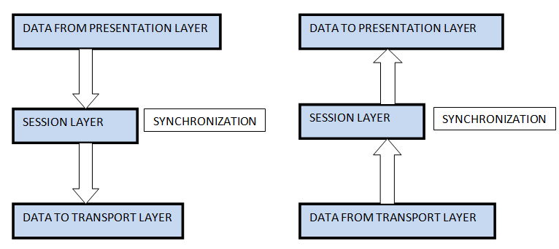
Session layer
This layer is responsible for the establishment of connection, maintenance of sessions, and authentication, and also ensures security.
Functions of the Session Layer
Session Establishment, Maintenance, and Termination: The layer allows the two processes to establish, use, and terminate a connection.
Synchronization: This layer allows a process to add checkpoints that are considered synchronization points in the data. These synchronization points help to identify the error so that the data is re-synchronized properly, and ends of the messages are not cut prematurely and data loss is avoided.
Dialog Controller: The session layer allows two systems to start communication with each other in half-duplex or full-duplex.

Slide 7
Transport layer
The transport layer provides services to the application layer and takes services from the network layer. The data in the transport layer is referred to as Segments . It is responsible for the end-to-end delivery of the complete message. The transport layer also provides the acknowledgment of the successful data transmission and re-transmits the data if an error is found.
At the sender’s side: The transport layer receives the formatted data from the upper layers, performs Segmentation , and also implements Flow and error control to ensure proper data transmission. It also adds Source and Destination port numbers in its header and forwards the segmented data to the Network Layer.
At the receiver’s side: Transport Layer reads the port number from its header and forwards the Data which it has received to the respective application. It also performs sequencing and reassembling of the segmented data.

Slide 8
Functions of transport layer
Segmentation and Reassembly: This layer accepts the message from the (session) layer, and breaks the message into smaller units. Each of the segments produced has a header associated with it. The transport layer at the destination station reassembles the message.
Service Point Addressing: To deliver the message to the correct process, the transport layer header includes a type of address called service point address or port address. Thus by specifying this address, the transport layer makes sure that the message is delivered to the correct process.
Services Provided by Transport Layer
1. Connection-Oriented Service: It is a three-phase process that includes:
Connection Establishment
Data Transfer
Termination/disconnection
In this type of transmission, the receiving device sends an acknowledgment, back to the source after a packet or group of packets is received. This type of transmission is reliable and secure.
2. Connectionless service: It is a one-phase process and includes Data Transfer. In this type of transmission, the receiver does not acknowledge receipt of a packet. This approach allows for much faster communication between devices. Connection-oriented service is more reliable than connectionless Service.

Slide 9
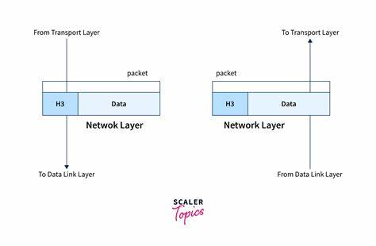
Network layer
The network layer works for the transmission of data from one host to the other located in different networks. It also takes care of packet routing i.e. selection of the shortest path to transmit the packet, from the number of routes available. The sender & receiver’s IP addresses are placed in the header by the network layer.
Functions of the Network Layer
Routing: The network layer protocols determine which route is suitable from source to destination. This function of the network layer is known as routing.
Logical Addressing: To identify each device inter-network uniquely, the network layer defines an addressing scheme. The sender & receiver’s IP addresses are placed in the header by the network layer. Such an address distinguishes each device uniquely and universally.

Slide 10
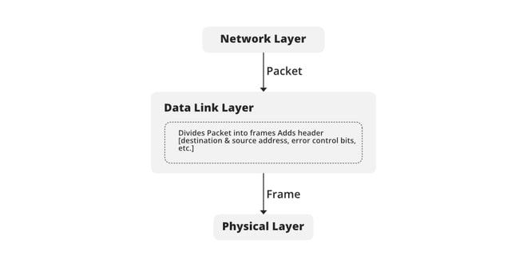
Data link layer
Framing: Framing is a function of the data link layer. It provides a way for a sender to transmit a set of bits that are meaningful to the receiver. This can be accomplished by attaching special bit patterns to the beginning and end of the frame.
Physical Addressing: After creating frames, the Data link layer adds physical addresses ( MAC addresses ) of the sender and/or receiver in the header of each frame.
Error Control: The data link layer provides the mechanism of error control in which it detects and retransmits damaged or lost frames.
Flow Control: The data rate must be constant on both sides else the data may get corrupted thus, flow control coordinates the amount of data that can be sent before receiving an acknowledgment.
Access Control: When a single communication channel is shared by multiple devices, the MAC sub-layer of the data link layer helps to determine which device has control over the channel at a given time.

Slide 11
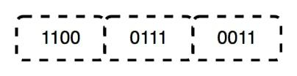
Physical layer
The lowest layer of the OSI reference model is the physical layer. It is responsible for the actual physical connection between the devices. The physical layer contains information in the form of bits. It is responsible for transmitting individual bits from one node to the next. When receiving data, this layer will get the signal received and convert it into 0s and 1s and send them to the Data Link layer, which will put the frame back together.
Functions of the Physical Layer
Bit Synchronization: The physical layer provides the synchronization of the bits by providing a clock. This clock controls both sender and receiver thus providing synchronization at the bit level.
Bit Rate Control: The Physical layer also defines the transmission rate i.e. the number of bits sent per second.
Physical Topologies: Physical layer specifies how the different, devices/nodes are arranged in a network i.e. bus, star, or mesh topology.
Transmission Mode: Physical layer also defines how the data flows between the two connected devices. The various transmission modes possible are Simplex, half-duplex and full-duplex.

Slide 12
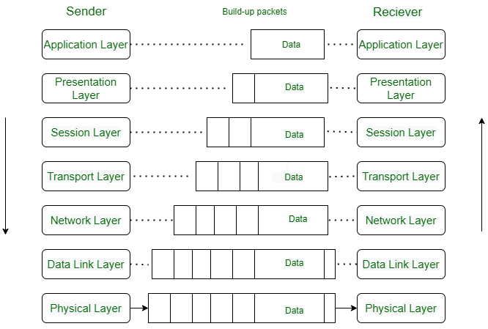
Data flow of OSI model
When we transfer information from one device to another, it travels through 7 layers of OSI model. First data travels down through 7 layers from the sender’s end and then climbs back 7 layers on the receiver’s end.
Data flows through the OSI model in a step-by-step process:
Application Layer: Applications create the data.
Presentation Layer: Data is formatted and encrypted.
Session Layer: Connections are established and managed.
Transport Layer: Data is broken into segments for reliable delivery.
Network Layer : Segments are packaged into packets and routed.
Data Link Layer: Packets are framed and sent to the next device.
Physical Layer: Frames are converted into bits and transmitted physically.

Slide 13


